Slide 1
Linux device driver
Day 15 PPT
-SUBITHRA s

Slide 2
Difference between dynamic linking and dlopen
Dynamic Linking:
Definition: dynamic linking is a mechanism where the linking of libraries or modules occurs at runtime rather than at compile time. In other words, the linking of libraries to an executable happens when the program is loaded into memory or during execution.
Usage: dynamic linking is a common practice in most modern operating systems. It allows for shared libraries (also known as dynamic-link libraries or .Dll files on windows, and shared objects or .So files on unix/linux) to be referenced by multiple programs simultaneously, saving memory space.
Advantages: dynamic linking allows for more flexible and efficient memory usage, as multiple programs can share the same library code in memory. It also facilitates easier updates to shared libraries without requiring recompilation of all dependent programs.

Slide 3
Difference between dynamic linking and dlopen
dlopen():
Definition: dlopen() is a function provided by the POSIX standard for dynamically loading a shared object file into a running process. It allows a program to load a shared library (.So file) at runtime, dynamically linking it to the program's address space.
Usage: dlopen() is commonly used in situations where a program needs to load plugins or extensions dynamically during execution, or when the specific library to be used is determined at runtime based on user input or system configuration.
Advantages: dlopen() provides a flexible mechanism for loading libraries dynamically, enabling the creation of modular and extensible software systems. It allows programs to adapt their behavior or functionality based on runtime conditions.

Slide 4
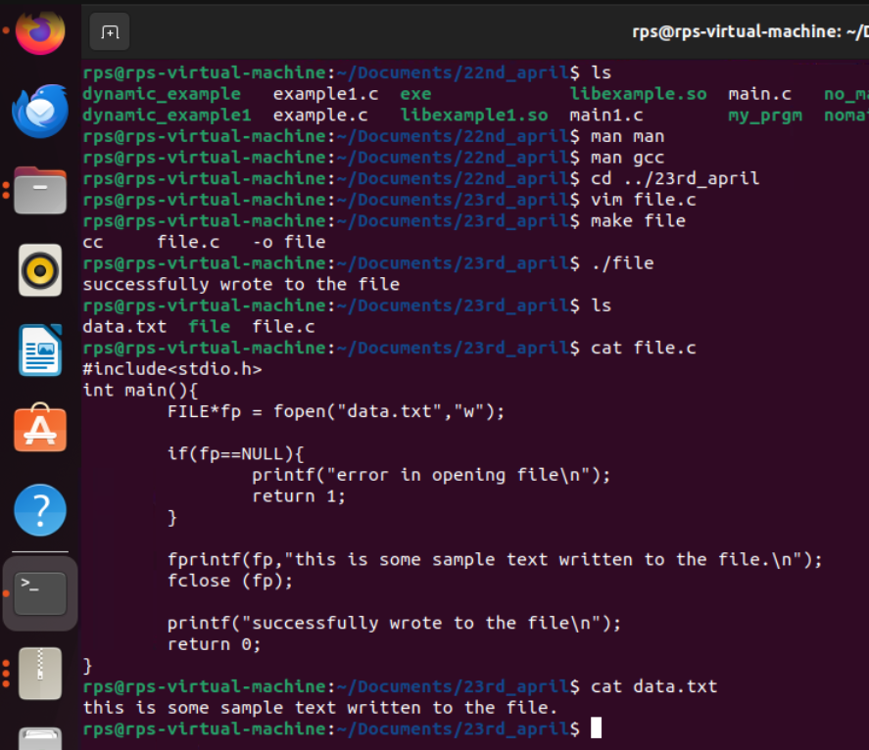
File operation
FILE *fp = fopen("data.txt", "w");: This line opens a file named "data.txt" in write mode ("w"). If the file does not exist, it will be created. If the file does exist, its contents will be overwritten. The fopen() function returns a pointer to a FILE structure, which is assigned to the variable fp.
fprintf(fp, "This is some sample text written to the file.\n");: This line writes the string "This is some sample text written to the file." followed by a newline character (\n) to the file pointed to by fp. It uses the fprintf() function, which works similarly to printf() but writes the formatted output to a file instead of the standard output (console).
fclose(fp);: This line closes the file associated with the file pointer fp. It's important to close files after you're done writing to them to release system resources.

Slide 5
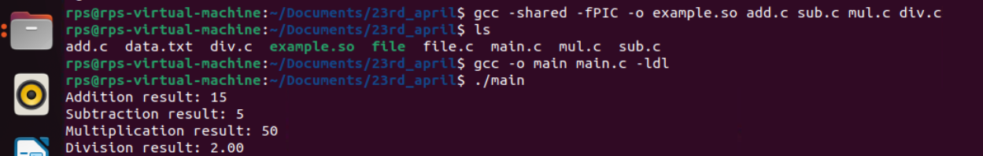
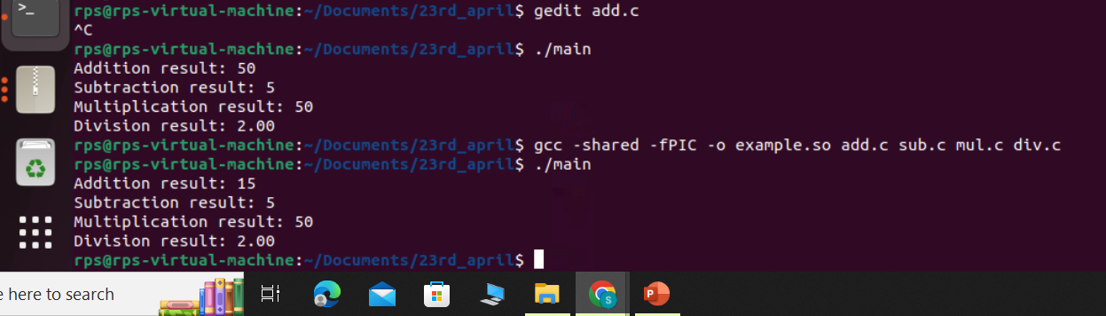
Execution with same executable even after modification

Slide 6
Modular programming
Modular code refers to the practice of breaking down a large program into smaller, manageable, and independent modules or components. Each module serves a specific purpose or functionality within the overall system. These modules can be developed, tested, and maintained separately, allowing for easier collaboration among developers and facilitating code reuse.
Encapsulation: modules encapsulate related functionality, data, or behavior, hiding the internal details from other parts of the program. This promotes information hiding and reduces complexity.
Abstraction: modules present a simplified interface to the rest of the program, abstracting away the implementation details. This allows other parts of the program to interact with the module without needing to understand its internal workings.
Reusability: modular code promotes code reuse by allowing modules to be used in multiple contexts. Once developed and tested, a module can be easily integrated into different projects or used multiple times within the same project.
Maintainability: breaking down a program into smaller modules makes it easier to understand, debug, and maintain. Changes made to one module are less likely to affect other modules, reducing the risk of unintended side effects.

Slide 7
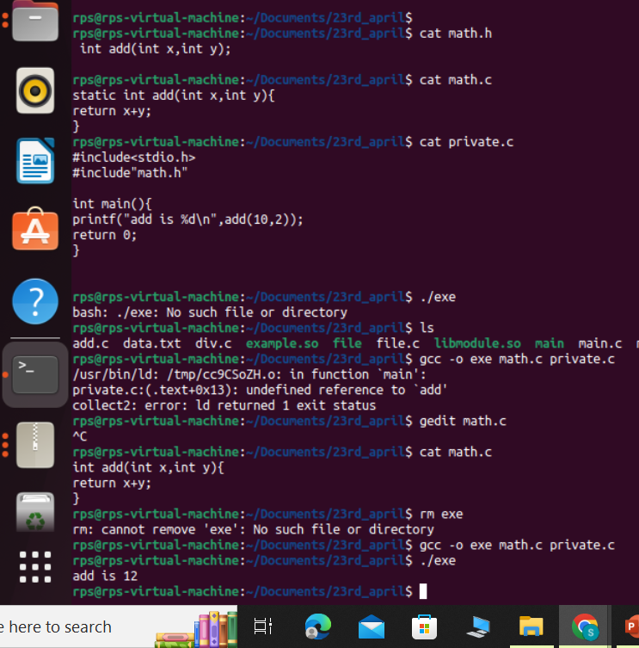
Making Variables Private:
Declaring a variable as static at the file level, it limits the scope of that variable to the file in which it is declared. Other translation units cannot access or modify this variable directly.

Slide 8
THANK YOU

